Slide 1

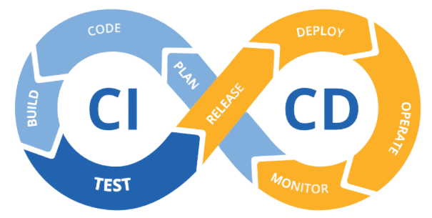







EPAM DevOps FINAL PROJECT (2021Q4)
Student: Taruraiev Oleksandr Oleksandrovich
CI/CD pipeline with VM, Jenkins, Terraform, Ansible, AWS

Slide 2

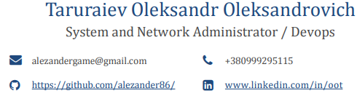
Information about the speaker
Summary: 13 years of experience in IT as a System Engineer (10yr.) and System Administrator (7yr.). Have experience in leading engineering teams and refining technical requirements with customers in the role of Product Owner. I also have a Computer Science degree.
I think, that the key to success in any business is a hard work and striving for be the best.
Education:
East Ukrainian National University 2008 - 2012 Master's degree: control and automation systems.
College of East Ukrainian National University 2004 -2008 Bachelor: Computer Programming and automated systems

Slide 3
Motivation of project
1.Try basic DevOps tools from lection material
2. Using the acquired knowledge to implement an autonomous pipeline and design it into a single project

Slide 4
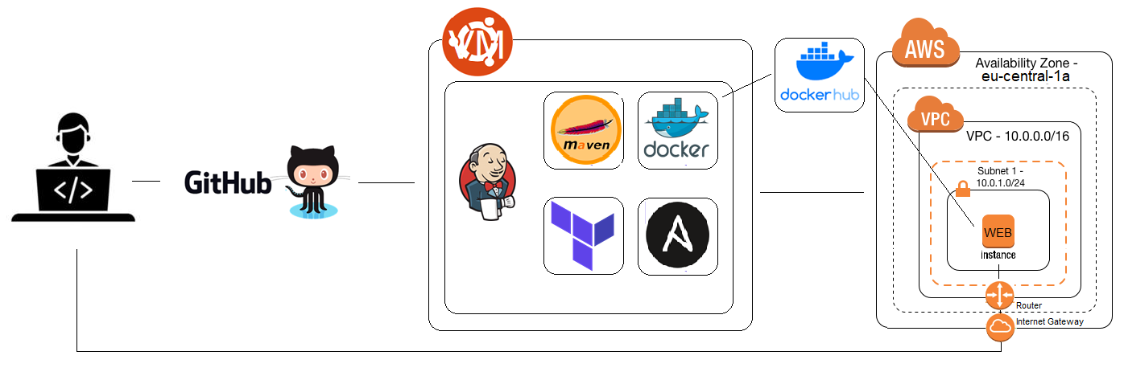
Pipeline scheme
Code pushed Github
GitHub update repo and knocking to Jenkins.
Jenkins based on preconfigured machine Oracle VM:
Jenkins download new code from GitHub
Jenkins tell the Maven to start testing and building the app.
Jenkins push application in to the Docker image and push it to DockerHub
Jenkins tell Terraform build new instance on AWS: VPC, Subnet, IG and install Ansible client.
Jenkins tell Ansible connect by ssh to AWS environment install docker start run image.
In the end of pipeline Jenkins send notification by mail and telegram job status and IP of server

Slide 5
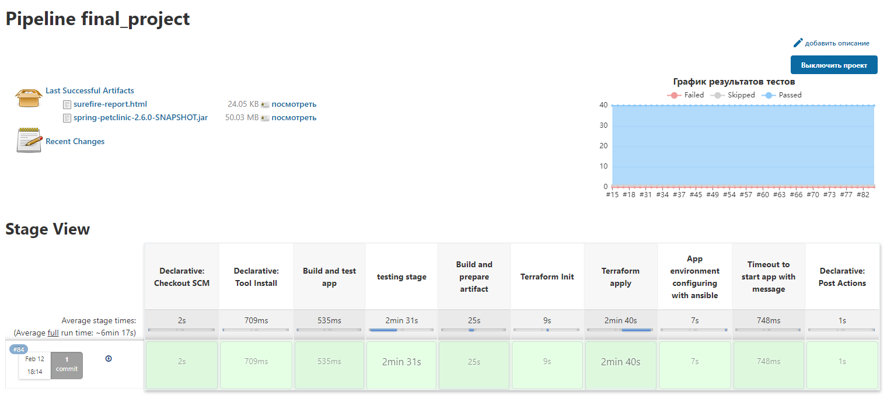
Project Stage view from Jenkins

Slide 6
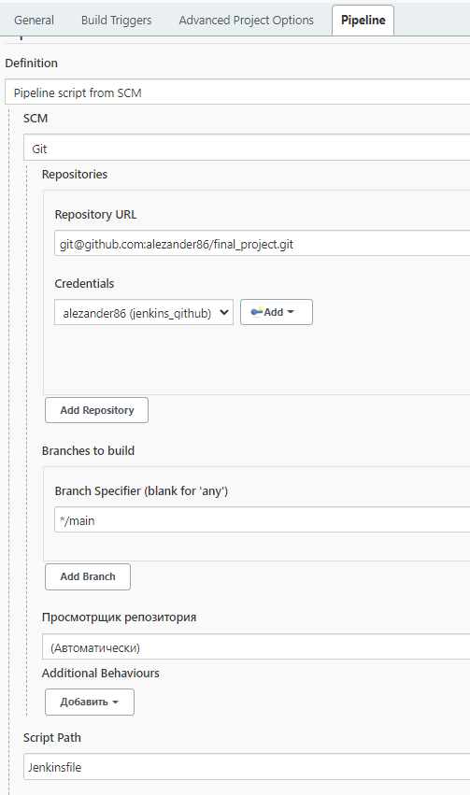
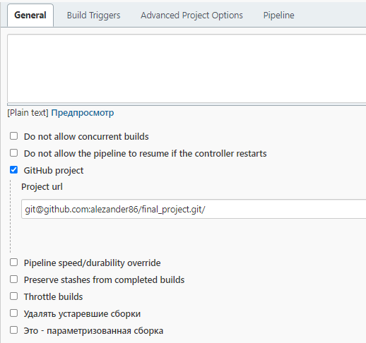
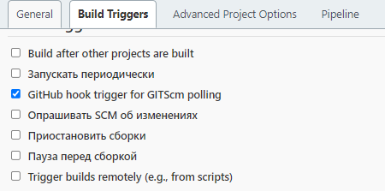
Jenkins project settings

Slide 7
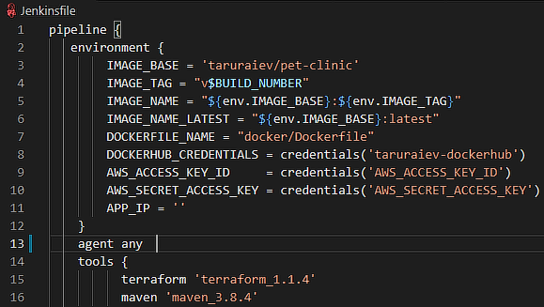
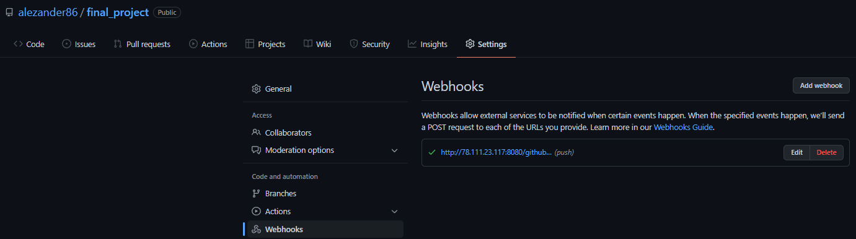
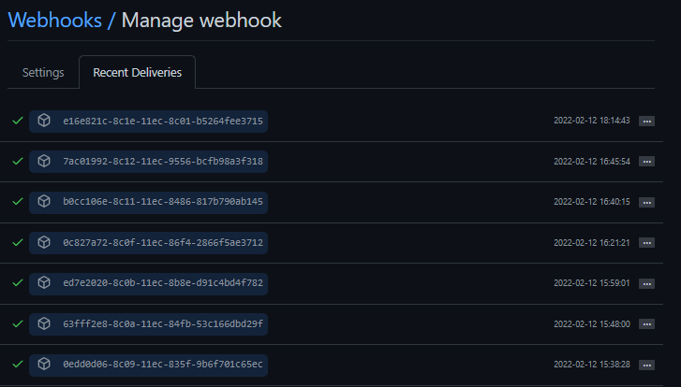
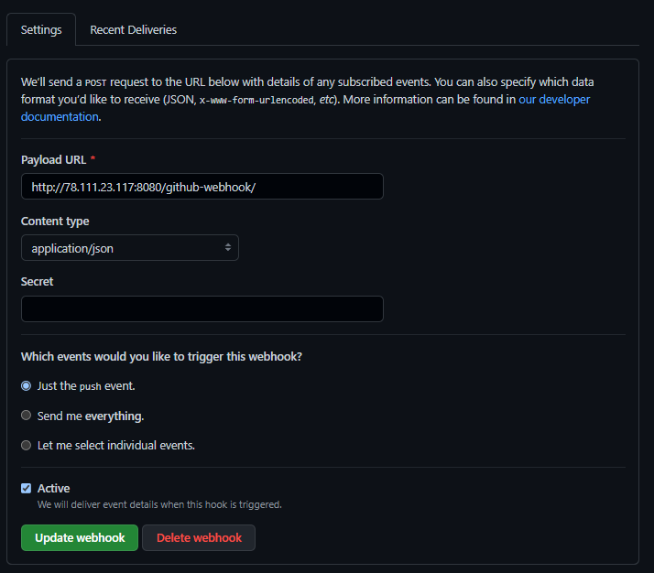
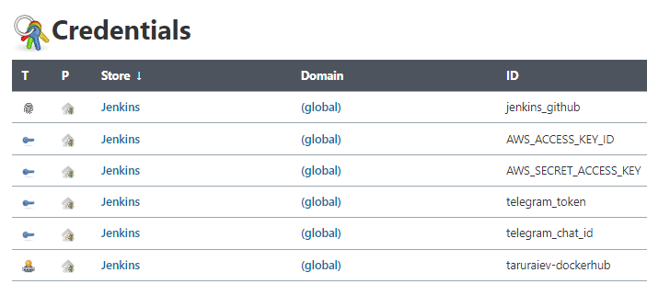
Jenkins credential, tools and GitHub hooks setting

Slide 8
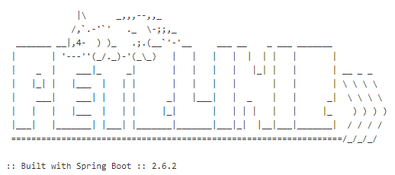
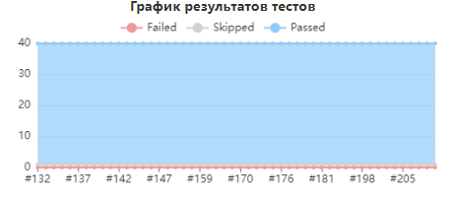
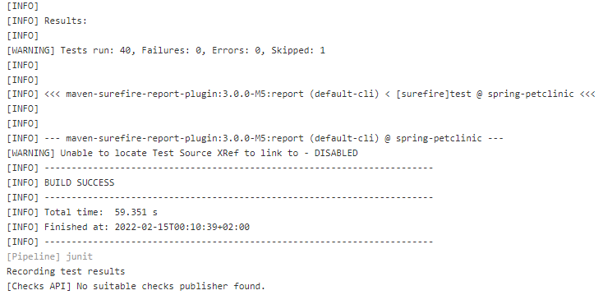
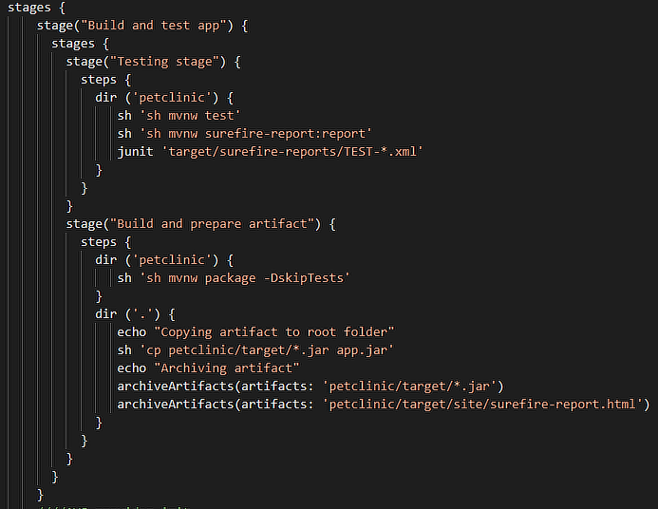
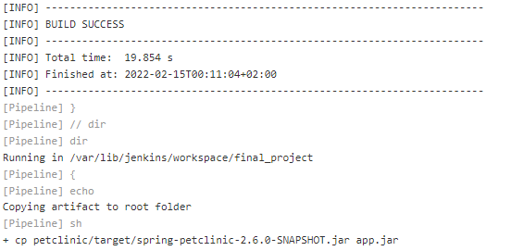
Maven
Testing stage
Build and prepare artifact

Slide 9
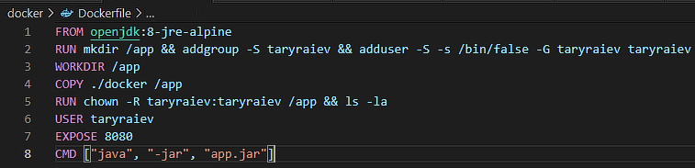
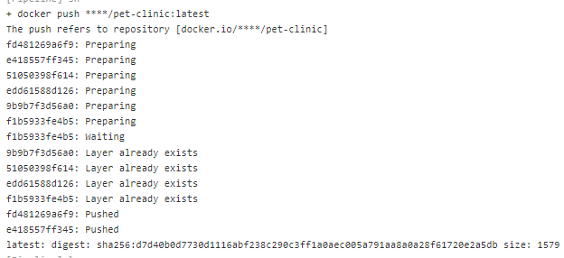
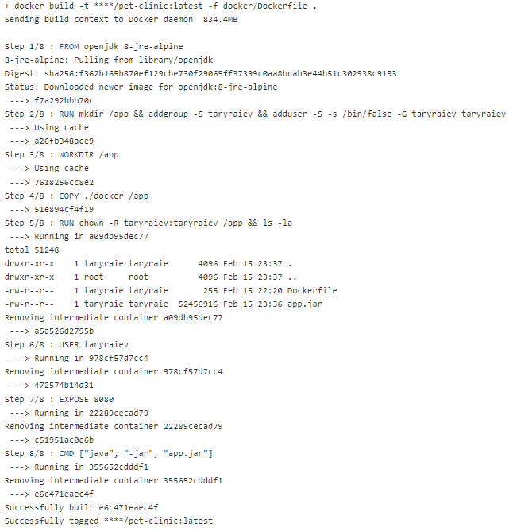
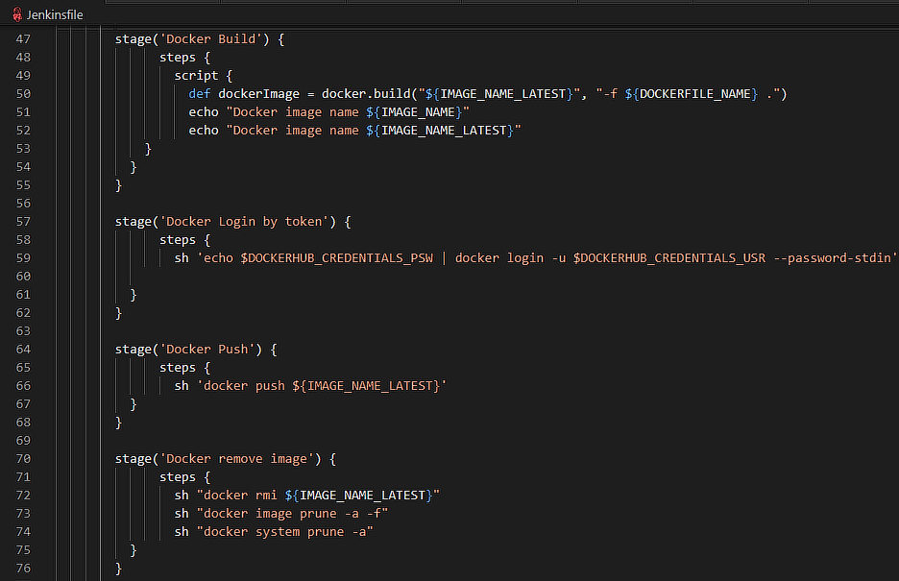
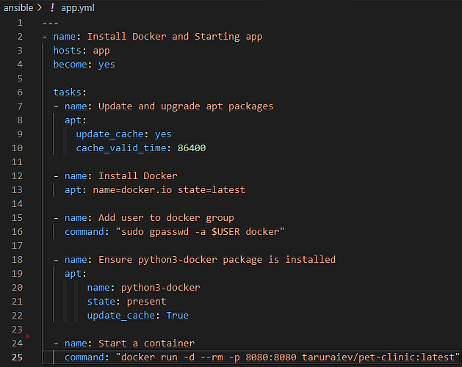
Docker
Build image
Push image to DockerHub
Remove image like old

Slide 10
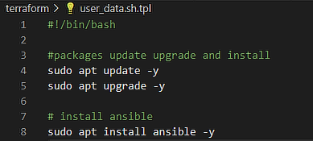
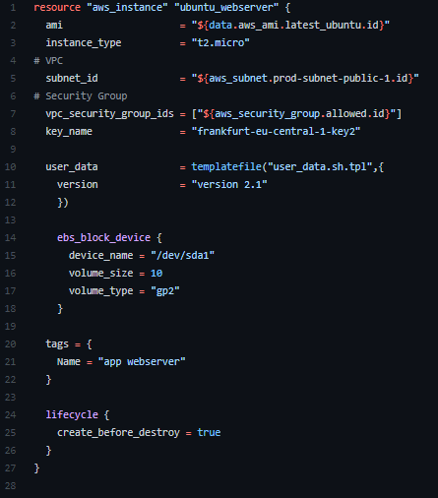
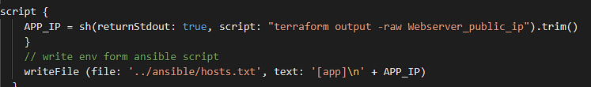
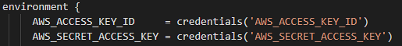
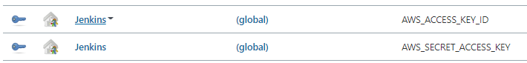
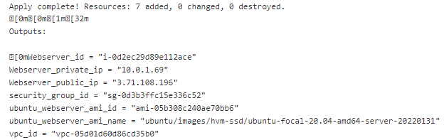
Terraform
Build instance
Take output with instance for host file
Install Ansible

Slide 11
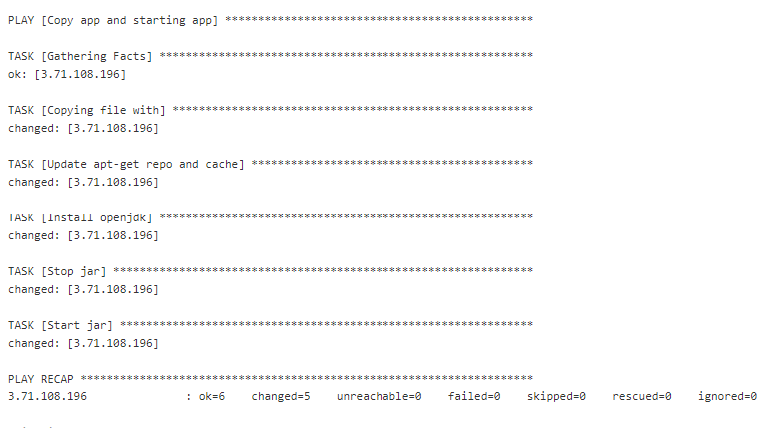

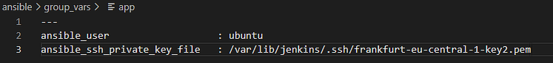
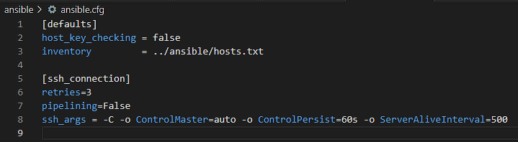
Ansible
Install Docker
And run Docker

Slide 12
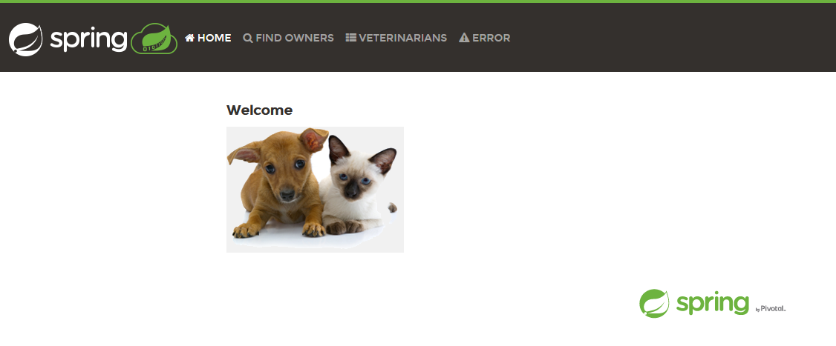
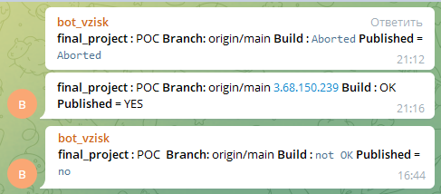
As Result we will receive notification and see application web page
Message output example
Thank you for your time and attention

